Slide 1
MEDICAL DISEASE DETECTOR
CREATED BY:
Muhammad Uzair
Aqib Mukhtar
Abdul Rehman

Slide 2
INTRODUCTION

Slide 3
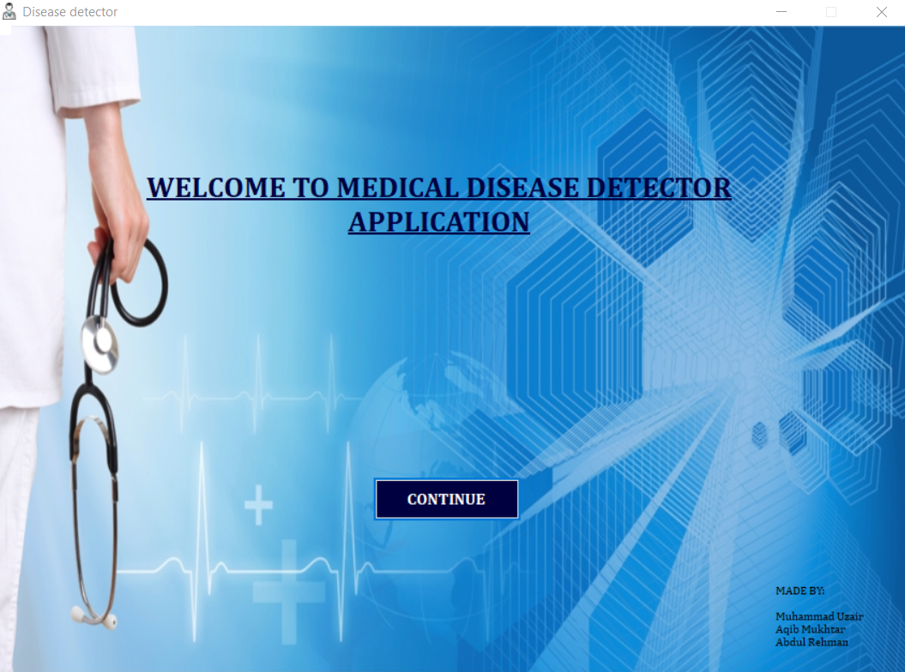
INTRODUCTION
Medical Disease Detector is an application that diagnoses the disease on the basis of symptoms that user inputs.
It also recommend medicine to cure the disease.
The record of patient is saved in a database.
The application also generates a report and print the report if printer is connected.

Slide 4
TECHNOLOGIES USED

Slide 5



TECHNOLOGIES USED
IDE: Visual Studio
LANGUAGE: C#
DATABASE: Microsoft Access

Slide 6
PURPOSE

Slide 7

PURPOSE
Modernizing the way of diagnosis and treatment.
Bringing Information Technology and Medical field closer.
Providing services to those who cannot visit doctors due to unavailability of medical
resources in area.
Providing services to travelers or foreign students who are new in the city.

Slide 8
OUR VISION

Slide 9
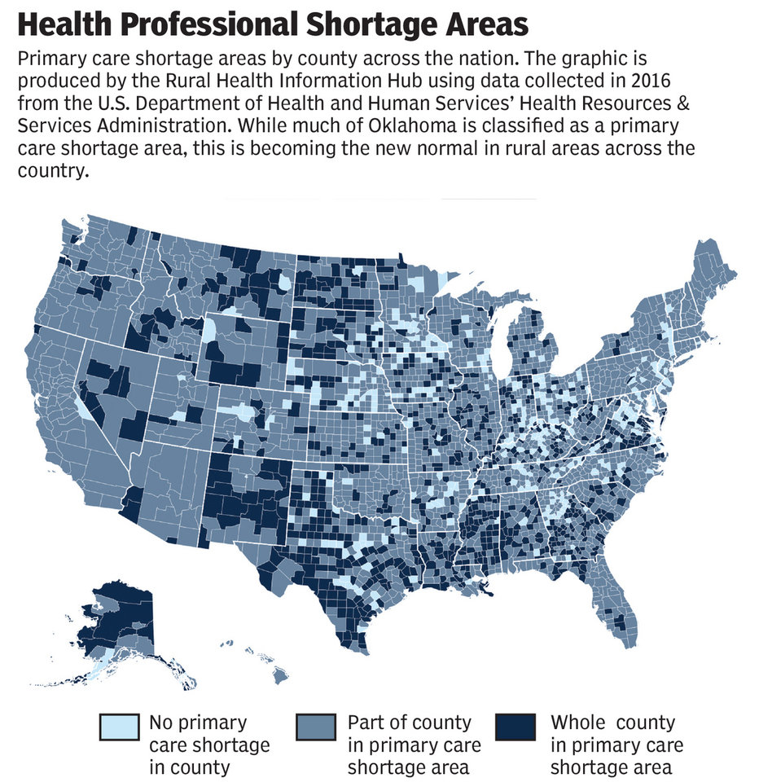
OUR VISION
A WHO and World Bank Group report launched on 12 June 2015 shows that 400 million people do not have access to essential health services
The report also shows that 6% of people in low- and middle-income countries are tipped into or pushed further into extreme poverty because of health spending.
Source: Rural Health Info

Slide 10
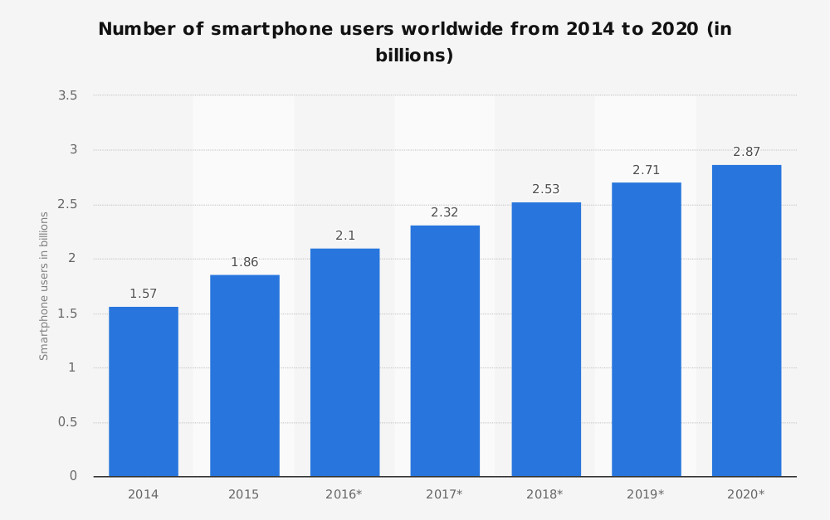
OUR VISION
In 2016, an estimated 62.9 percent of the population worldwide already owned a mobile phone.
The number of smartphone users in the world is expected to reach 2.7 billion by 2019.
Source: E Marketer Statista

Slide 11
BUT WHAT DOES SMARTPHONES HAS TO DO WITH HEALTH CARE?

Slide 12
OUR VISION
The reports of world bank and WHO show that Half the world lacks access to essential health services while 100 million still pushed into extreme poverty because of health expenses.
On the other hand about 76% population of the world is currently using smartphones.
The lack of Medical Services can be fulfilled by smartphones through this Application.

Slide 13
FUTURE PLANS

Slide 14
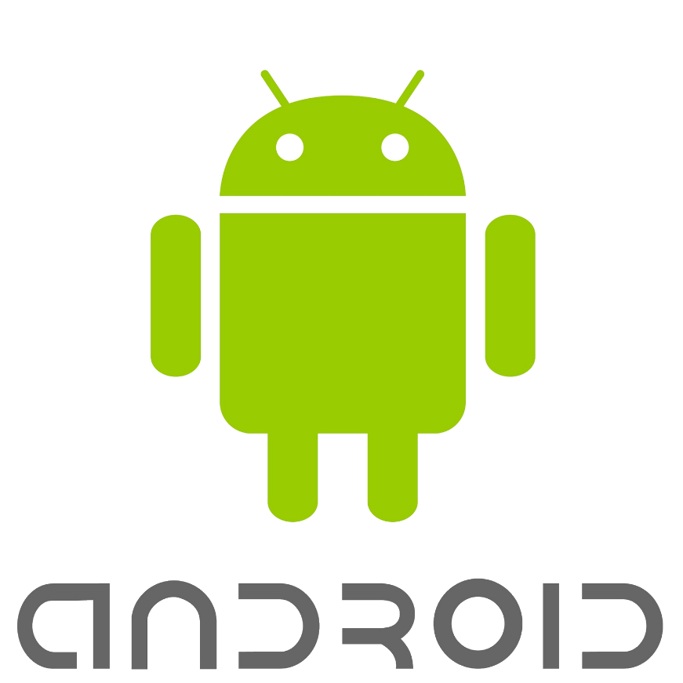
CONVERTING TO ANDROID
In future we plan to convert our application to android.
Converting the application to android will make it available to every person having an android smartphone.

Slide 15
THANK YOU

